Slide 1

Zachman Framework: Row 1 (Scope)
Jasmita Maharaj
Susy Simanullang
Tim Wilkie

Slide 2
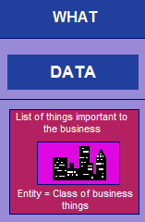
Professional, Custom Designed website.
A calendar to track and show the scheduled performances and auditions with date and time information.
Video, Pictures, testimonials, and Blog sections .
A means contact via email.
Domain Name.
Logo
Client and Financial tracking

Slide 3
Cold calling.
Promotional Packages.
Auditions for dancers and band.

Slide 4
Present:
Seattle area (also Portland & Spokane)
Private event: weddings
Public event: pubs
Future:
Northwest area, West Coast area, and US
Public event: casinos
Online
Present: blog site and Facebook
Future: Twitter and Youtube
Share info & pictures by email, Google docs, and Picasa

Slide 5
Dancers
Band members
Clients
Target audience: young generation
Public
Looking for sponsors: bars and local beer companies

Slide 6
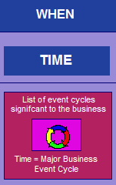
Open 3 months
As soon as possible (with only the blog site and Gmail, it is hard to advertise)
First need a business process
Have 1, 3, and 5 year plans

Slide 7
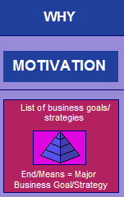
Bring Irish Dance to 21st century
Empowered female dancers
Goals:
1 year – promotional videos, posters, logos, and t-shirts
3 year – put together a band, west coast tour, and expand client list
5 year – US tour, workshops, own dance studio

Slide 8
What (Data)
The PLOS need to map to the CLOS
The outcomes need to match

Slide 9
How (Function)
Process
Application
Self evaluation
Candidacy
Evaluation
Decision
Accreditation
Dues and Fees
Institutional Responsibilities
Commission Responsibilities

Slide 10
The existing PLOS data is stored in a Google spreadsheet
The catalog can be accessed online at Edmonds Community College website

Slide 11
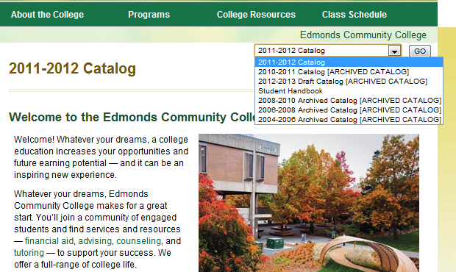

Slide 12
Faculty
Departments
Vice President of Instruction
Edmonds Community College
Students
NWCCU

Slide 13
EDCC ACCREDITATION
Evaluation Schedule of Accreditation Reports and Visits (2011 - 2018)
Milestones
Standardized nomenclature for the degree requirements areas
Linking PLOS to courses
Audit planning sheets for IRC guideline compliance
Institution | Season | 2011 | 2012 | 2013 | 2014 | 2015 | 2016 | 2017 | 2018
EDCC | Spring | Yr 1 report |  | Yr 3 report and visit |  | Yr 5 report |  | Yr 7 report and visit | Yr 1 report

Slide 14
Funding ( student financial aid)
Current catalog is not standardized
Need to map PLOS to CLOS
Student learning outcomes
Accessing course outcome
Agreement between colleges

Slide 15
Quick Overview

